Slide 1
Text Book: 1. Principles of Information Security, Michael E., Whitman & Mattord, H. J., Cengage Learning, 2017.

Slide 2
What is Security?
Definition: “the quality or state of being secure—to be free from danger”
Security is often achieved by means of several strategies undertaken simultaneously or used in combination with one another
Organizational Security Layers:
Physical security
Personnel security
Operations security
Communications security
Network security

Slide 3
What is Information Security?
Information security
The protection of information and its critical elements (confidentiality, integrity and availability), including the systems and hardware that use, store, and transmit that information
Achieved through the application of policy, technology, and training and awareness programs

Slide 4
Key Information Security Concepts
Access: A subject or object’s ability to use, manipulate, modify, or affect another subject or object. Authorized users have legal access to a system, whereas hackers have illegal access to a system
Asset: The organizational resource that is being protected. An asset can be logical, such as a Web site, information, or data; or an asset can be physical, such as a person, computer system
Attack: An intentional or unintentional act that can cause damage to or otherwise compromise information and/or the systems that support it. Attacks can be passive, intentional or unintentional, and direct or indirect

Slide 5
Key Information Security Concepts(Cont)
Exploit: A technique used to compromise a system. Threat agents may attempt to exploit a system or other information asset by using it illegally for their personal gain
Exposure: A condition or state of being exposed. In information security, exposure exists when a vulnerability known to an attacker is present
Loss: A single instance of an information asset suffering damage or unintended or unauthorized modification or disclosure. When an organization’s information is stolen, it has suffered a loss

Slide 6
Key Information Security Concepts (Cont)
Risk: danger or harm arising from unauthorized access. causing harm to an organization or system e.g. financial loss, reputational damage
Threats: A person, object or any other entity that presents a danger to an assets. potential danger or harmful event that exploit a weakness in a system security e.g. Malware, attack
Threat Agents: Hacker
Vulnerability: Weakness in system security that could exploited by a threat software flaws, weak passwords

Slide 7
Critical Characteristics of Information
The value of information comes from the characteristics it possesses. When a characteristic of information changes, the value of that information either increases, or, more commonly, decreases
Availability: enables authorized users—persons or computer systems—to access information without interference or obstruction and to receive it in the required format
Accuracy: Information has accuracy when it is free from mistakes or errors and it has the value that the end user expects. If information has been intentionally or unintentionally modified, it is no longer accurate
Authenticity: Authenticity of information is the quality or state of being genuine or original, rather than a reproduction or fabrication. Information is authentic when it is in the same state in which it was created, placed, stored, or transferred

Slide 8
Critical Characteristics of Information (Cont)
Confidentiality: Information has confidentiality when it is protected from disclosure or exposure to unauthorized individuals or systems
Measures used to protect confidentiality
Information classification
Secure document storage
Application of general security policies
Education of information custodians and end users
Utility: The utility of information is the quality or state of having value for some purpose or end. Information has value when it can serve a purpose. If information is available, but is not in a format meaningful to the end user, it is not useful
Integrity: Information has integrity when it is whole, complete, and uncorrupted. Information integrity is threatened If exposed to corruption, damage, destruction, or other disruption of its authentic state. Corruption can occur while information is being compiled, stored, or transmitted
Possession: refers to holding, control and ability to use like student portal

Slide 9
Committee on National Security Systems(CNSS) Model
Created by John McCumber in 1991, provides a graphical representation of the architectural approach widely used in computer and information security
Also known as the McCumber Cube
Provides a more detailed perspective on security
Covers the three dimensions of information security three dimensions- 3x3x3 cube with 27 cells representing areas that must be addressed to secure today information systems
Notes:
The McCumber Cube in Figure 1-6, shows three dimensions. If extrapolated, the three dimensions of each axis become a 3 3 3 cube with 27 cells representing areas that must be addressed to secure today’s information systems. To ensure system security, each of the 27 areas must be properly addressed during the security process.

Slide 10
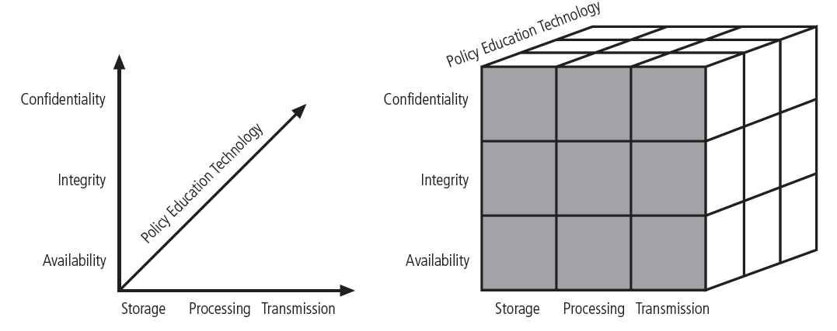
CNSS Security Model (Cont)

Slide 11
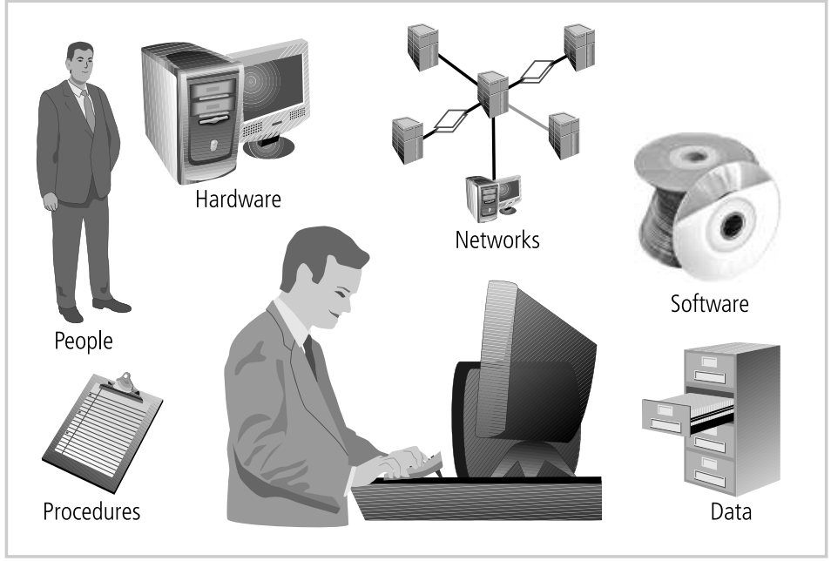
Components of Information Security

Slide 12
Components of Information Security
Software: The software component of the IS comprises applications, operating systems, and assorted command utilities. Software is perhaps the most difficult IS component to secure
Hardware: Hardware is the physical technology that houses and executes the software, stores and transports the data, and provides interfaces for the entry and removal of information from the system
Data: Data stored, processed, and transmitted by a computer system must be protected. Data is often the most valuable asset possessed by an organization and it is the main target of intentional attacks

Slide 13
Components of Information Security
People: have always been a threat to information security. people can be the weakest link in an organization’s information security program. And unless policy, education and training, awareness, and technology are properly employed to prevent people from accidentally or intentionally damaging or losing information, they will remain the weakest link
Procedures: Procedures are written instructions for accomplishing a specific task. When an unauthorized user obtains an organization’s procedures, this poses a threat to the integrity of the information
Networks: When information systems are connected to each other to form local area networks (LANs), and these LANs are connected to other networks such as the Internet, new security challenges rapidly emerge. The physical technology that enables network functions is becoming more and more accessible to organizations of every size

Slide 14
Balancing Information Security and Access
It is impossible to obtain perfect security - it is not an absolute; it is a process not a goal
Security should be considered a balance between protection and availability
To achieve balance, the level of security must allow reasonable access, yet protect against threats

Slide 15
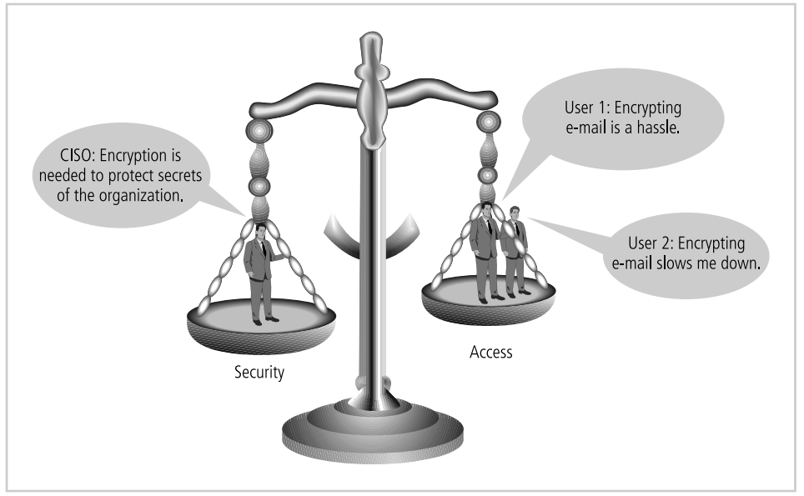
Balancing Information Security and Access

Slide 16
Approaches to Information Security Implementation
Bottom Up Approach
Information security can begin as a grassroots effort in which systems administrators attempt to improve the security of their systems this is referred as bottom up approach
System administrator knows and understand the threats to their system and the mechanism needed to protect them
Key advantage - technical expertise of the individual administrators
Due to the lack of cooperation between senior managers and relevant directives, it is often not suitable for the requirements and strategies of the organization.

Slide 17
Approaches to Information Security Implementation(Cont)
Top-down Approach
Initiated by upper management
General requirements to specific requirements
issue policy, procedures, and processes
dictate the goals and expected outcomes of the project
determine who is accountable for each of the required actions
Higher probability of success
This approach has strong upper management support, a dedicated champion, dedicated funding, clear planning, and the chance to influence organizational culture
May also involve a formal development strategy referred to as a systems development life cycle

Slide 18
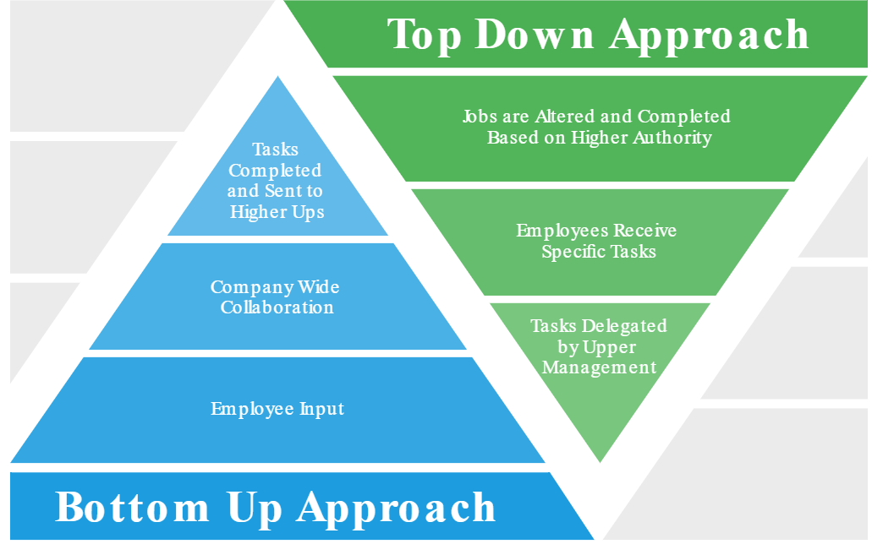
Approaches to Information Security Implementation(Cont)

Slide 19
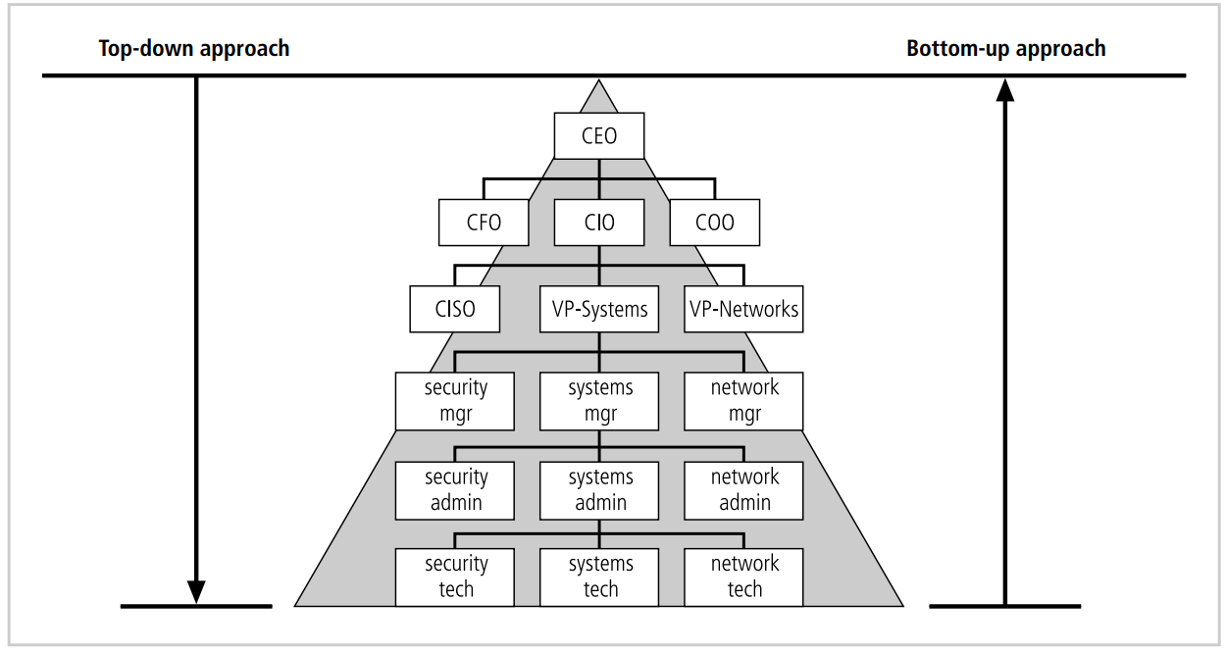
Approaches to Information Security Implementation(Cont)

Slide 20
Systems Development Life Cycle (SDLC)
methodology for the design and implementation of an information system
Using a methodology
ensures a rigorous process
avoids missing steps
The goal is creating a comprehensive security program

Slide 21
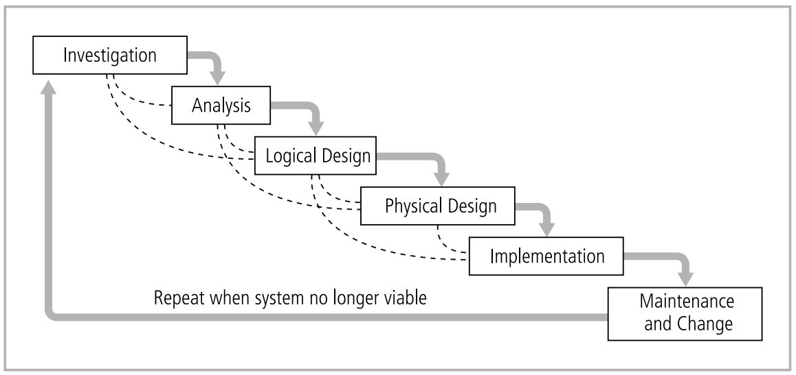
Systems Development Life Cycle (SDLC)

Slide 22
Systems Development Life Cycle (SDLC)
Investigation
Analysis
Logical design
Physical design
Implementation
Maintenance

Slide 23
Investigation
What is the problem the system is being developed to solve?
The objectives, constraints, and scope of the project are specified
A preliminary cost/benefit analysis is developed
A feasibility analysis is performed to assesses the economic, technical, and behavioral feasibilities of the process

Slide 24
Analysis
Consists primarily of
assessments of the organization
the status of current systems
capability to support the proposed systems
Analysts begin to determine
what the new system is expected to do
how the new system will interact with existing systems
Ends with the documentation of the findings and a feasibility analysis update

Slide 25
Logical Design
Based on business need, applications are selected capable of providing needed services
Based on applications needed, data support and structures capable of providing the needed inputs are identified
Finally, based on all of the above, select specific ways to implement the physical solution are chosen
At the end, another feasibility analysis is performed

Slide 26
Physical Design
Specific technologies are selected to support the alternatives identified and evaluated in the logical design
Selected components are evaluated based on a make-or-buy decision
Entire solution is presented to the end-user representatives for approval

Slide 27
Implementation
Components are ordered, received, assembled, and tested
Users are trained and documentation created
Users are then presented with the system for a performance review and acceptance test

Slide 28
Maintenance and Change
Tasks necessary to support and modify the system for the remainder of its useful life
The life cycle continues until the process begins again from the investigation phase
When the current system can no longer support the mission of the organization, a new project is implemented

Slide 29
Securing the SDLC
implementation of a system should be secure and does not risk compromising the confidentiality, integrity, and availability of the organization’s information assets

Slide 30
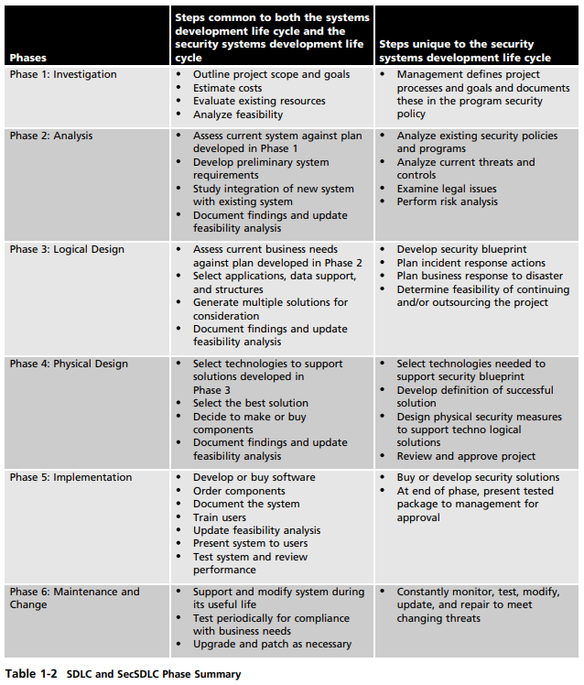
SDLC and SecSDLC Phase Summary

